Slide 1
ONLINE MOVIE ORDER SYSTEM
INFO 6210 | Group 5 Final Project
Fangyu Cui & Fang-Wen Tseng & Jiawen Yin & Xiaohe Zhang

Slide 2
Business Problem
ONLINE MOVIE ORDER SYSTEM
| BUSINESS PROBLEMS
As a platform of Online Movie Order System, the purpose of the database is to maintain, manage and update the data used to support customers’ online movie orders.
Customers can order movies online and get access to the movie in a limited time.
Staff can maintain the data of transactions within the platform, track the online movie orders status in customers’ accounts, manage the data of customers and movies to support customers’ orders.
Through the database, the platform can not only show every detail of current available movies and update the new release movies promptly, but also provide better search experience for potential customers.
The database will be used by administrative staff only.
INFO 6210 | Group 5 Final Project | Fangyu Cui & Fang-Wen Tseng & Jiawen Yin & Xiaohe Zhang

Slide 3
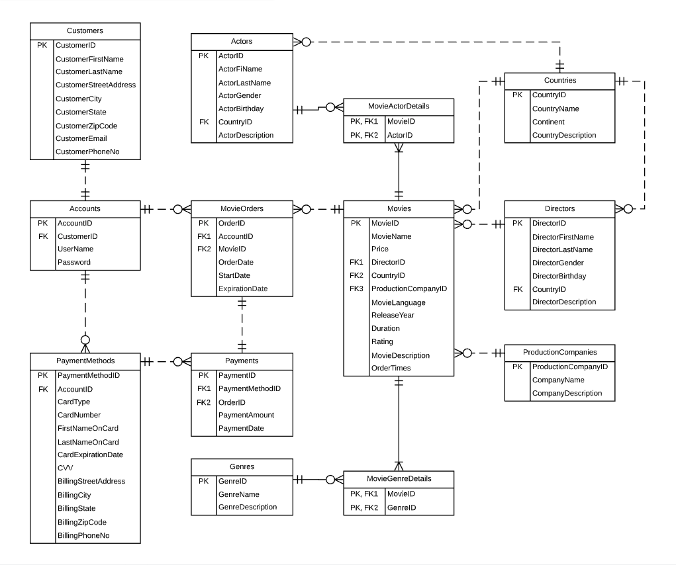
AWARDS
ONLINE MOVIE ORDER SYSTEM
| FINAL ERD
INFO 6210 | Group 5 Final Project | Fangyu Cui & Fang-Wen Tseng & Jiawen Yin & Xiaohe Zhang

Slide 4
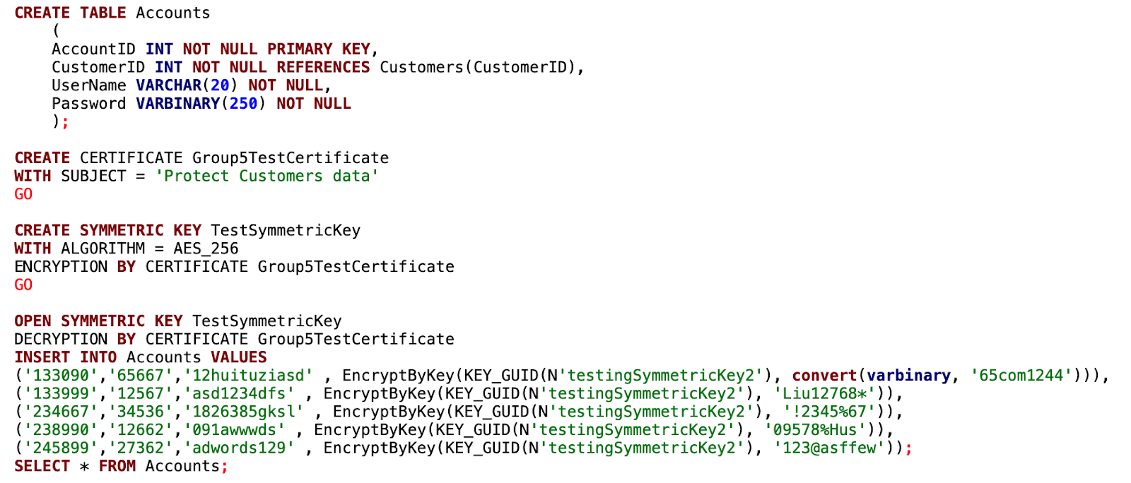
ONLINE MOVIE ORDER SYSTEM
| PROJECT HIGHLIGHTS
Data Encryption of Accounts.Password
We used data column encryption techniques to encrypt our customer’s password by using symmetric key
We controlled the permission on the passwords that we stored in our database
This can help secure our customers’ privacy
INFO 6210 | Group 5 Final Project | Fangyu Cui & Fang-Wen Tseng & Jiawen Yin & Xiaohe Zhang

Slide 5
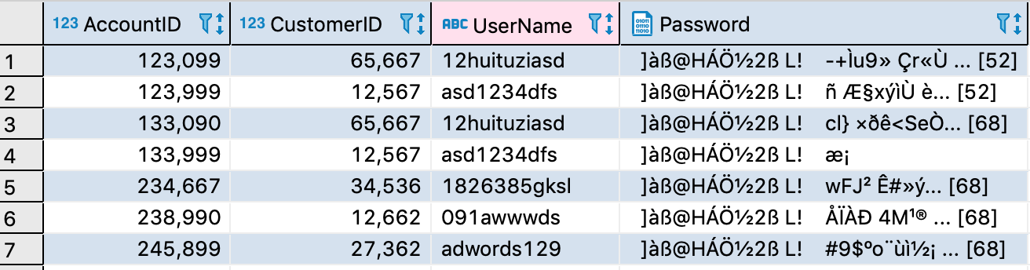
ONLINE MOVIE ORDER SYSTEM
| PROJECT HIGHLIGHTS
Results of our encryption on Passwords
Here, you can see the password has been encrypted for our customers
INFO 6210 | Group 5 Final Project | Fangyu Cui & Fang-Wen Tseng & Jiawen Yin & Xiaohe Zhang

Slide 6
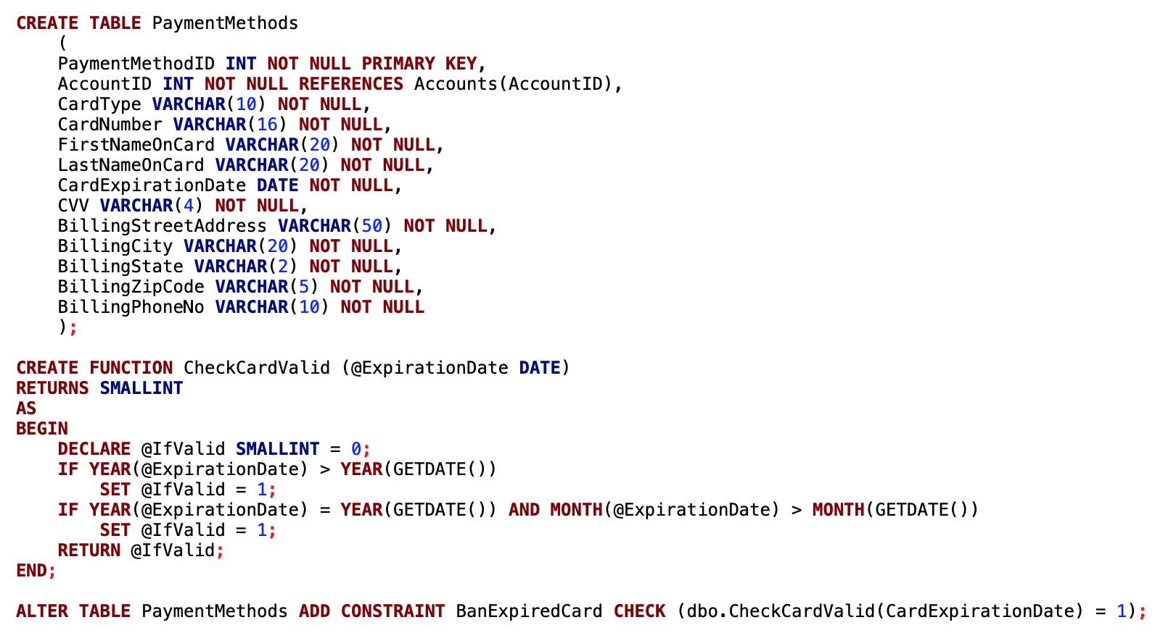
ONLINE MOVIE ORDER SYSTEM
| PROJECT HIGHLIGHTS
CHECK Constraints of PaymentMethods.CardExpirationDate
We used Table-level CHECK Constraints based on the function of checking credit card valid date to confirm that the inserted credit card is valid.
We compare the expiration date of the inserted card with the current date through the function.
If the expiration date is earlier, it means that the card is already expired and we will prevent the insertion of the card.
INFO 6210 | Group 5 Final Project | Fangyu Cui & Fang-Wen Tseng & Jiawen Yin & Xiaohe Zhang

Slide 7
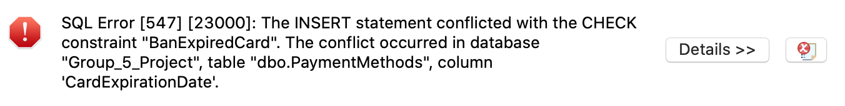
ONLINE MOVIE ORDER SYSTEM
| PROJECT HIGHLIGHTS
CHECK Constraints of PaymentMethods.CardExpirationDate
INFO 6210 | Group 5 Final Project | Fangyu Cui & Fang-Wen Tseng & Jiawen Yin & Xiaohe Zhang

Slide 8

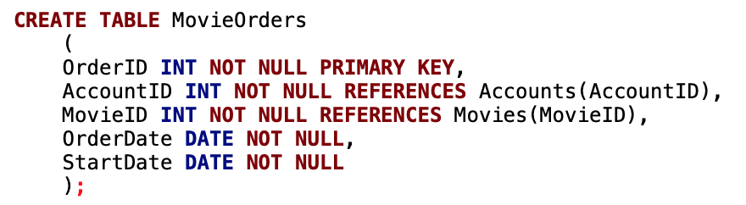
ONLINE MOVIE ORDER SYSTEM
| PROJECT HIGHLIGHTS
CHECK Constraints of MovieOrders.StartDate
We used Table-level CHECK Constraints based on the function of checking movie order’s start date to confirm that the chosen start date is correct. As customers can choose to start the movie availability from the day when they place the order or a later date, the start date should be no earlier than the order date.
We compare the start date and the order date of the inserted order through the function.
If the start date is earlier than the order date, it means that the start date is entered incorrectly and we will prevent the insertion of the order data.
INFO 6210 | Group 5 Final Project | Fangyu Cui & Fang-Wen Tseng & Jiawen Yin & Xiaohe Zhang

Slide 9
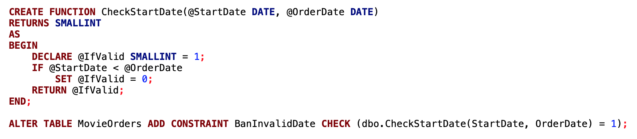

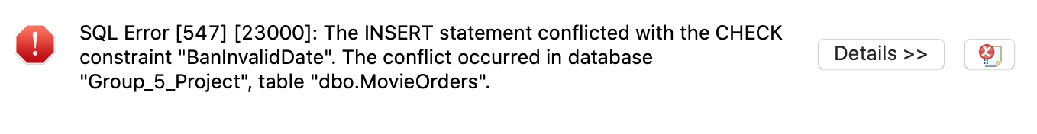
ONLINE MOVIE ORDER SYSTEM
| PROJECT HIGHLIGHTS
CHECK Constraints of MovieOrders.StartDate
INFO 6210 | Group 5 Final Project | Fangyu Cui & Fang-Wen Tseng & Jiawen Yin & Xiaohe Zhang

Slide 10

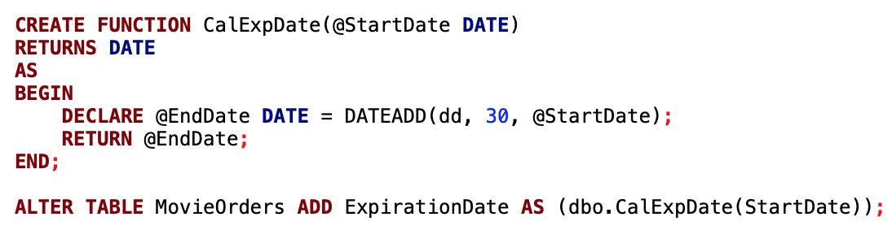
ONLINE MOVIE ORDER SYSTEM
| PROJECT HIGHLIGHTS
Computed Column of MovieOrders.ExpirationDate
We used computed column based on the function of calculating movie order expiration date to automatically insert the data of expiration date according to start date.
As the duration of movie order is 30 days, we can calculate the order expiration date based on the start date.
INFO 6210 | Group 5 Final Project | Fangyu Cui & Fang-Wen Tseng & Jiawen Yin & Xiaohe Zhang

Slide 11

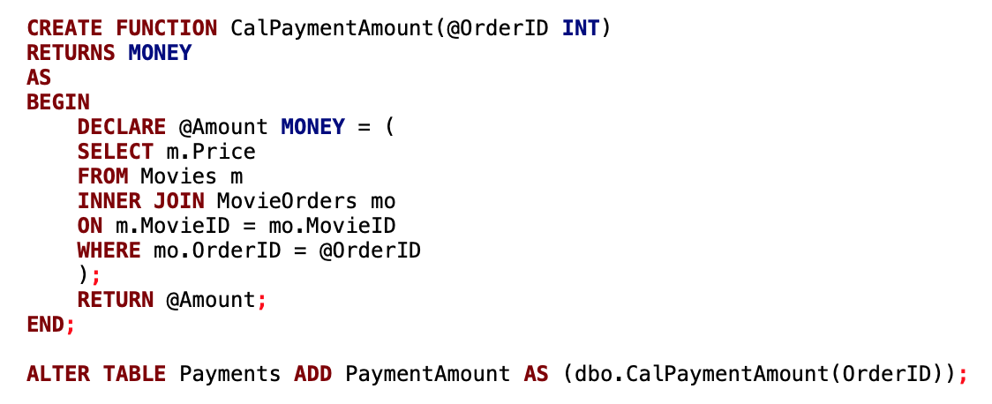
ONLINE MOVIE ORDER SYSTEM
| PROJECT HIGHLIGHTS
Computed Column of Payments.PaymentAmount
We used computed column based on the function of calculating payment amount of payments automatically.
As one order is related to one movie, we can find the order based on the order id of payment, then find the ordered movie based on the movie id in the order, and calculate the payment amount according to the price of the movie.
INFO 6210 | Group 5 Final Project | Fangyu Cui & Fang-Wen Tseng & Jiawen Yin & Xiaohe Zhang

Slide 12

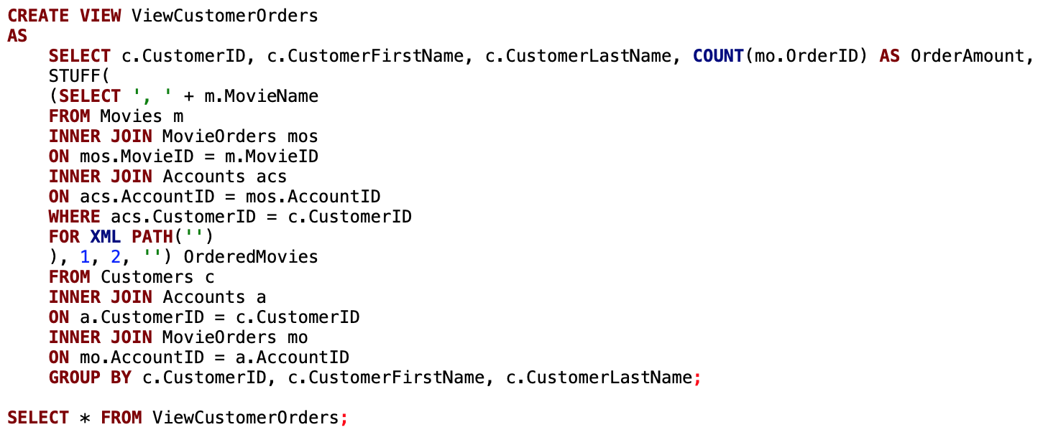
ONLINE MOVIE ORDER SYSTEM
| VIEWS FOR REPORTING
View of Customers’ Order Amount and Ordered Movies
We created a view of customers’ order amount and the list of movies that they have ordered.
We counted the number of order id related to the customer to calculate the order amount and listed all the distinct movie names of the customer’s orders in horizontal format.
INFO 6210 | Group 5 Final Project | Fangyu Cui & Fang-Wen Tseng & Jiawen Yin & Xiaohe Zhang

Slide 13
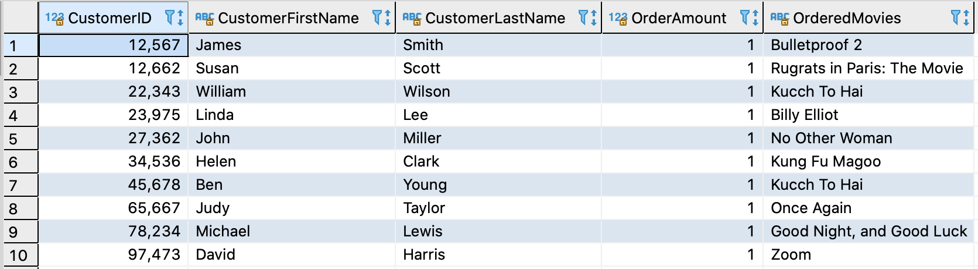
ONLINE MOVIE ORDER SYSTEM
| VIEWS FOR REPORTING
View of Customers’ Order Amount and Ordered Movies
INFO 6210 | Group 5 Final Project | Fangyu Cui & Fang-Wen Tseng & Jiawen Yin & Xiaohe Zhang

Slide 14

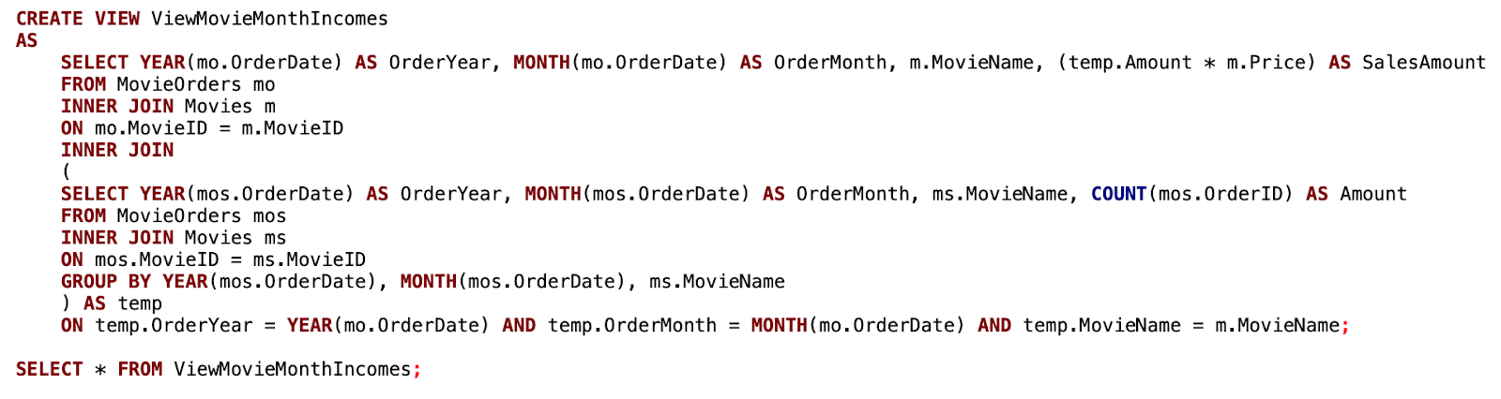
ONLINE MOVIE ORDER SYSTEM
| VIEWS FOR REPORTING
View of Movies’ Monthly Incomes
We created a view to calculate each movie’s monthly incomes.
We calculated the order times of each movie in each month and multiplied the price of movie for the total income. The result listed the month, the movie’s name and the income amount.
INFO 6210 | Group 5 Final Project | Fangyu Cui & Fang-Wen Tseng & Jiawen Yin & Xiaohe Zhang

Slide 15
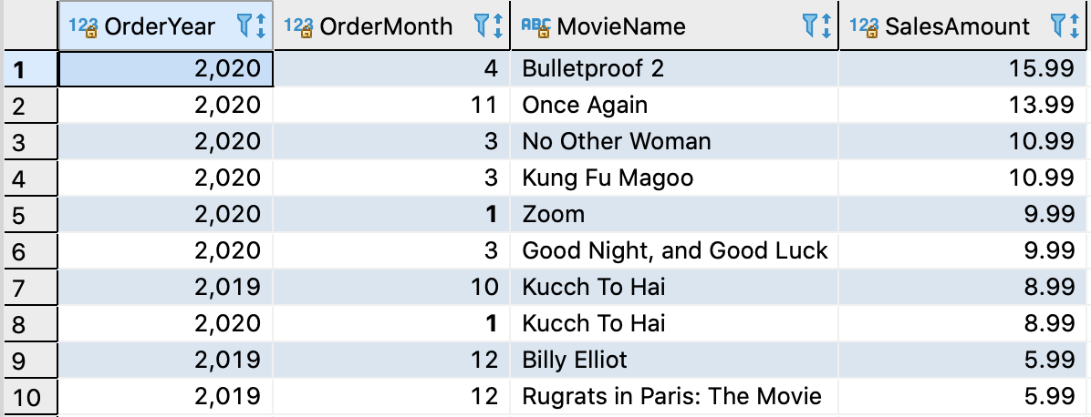
ONLINE MOVIE ORDER SYSTEM
| VIEWS FOR REPORTING
View of Movies’ Monthly Incomes
INFO 6210 | Group 5 Final Project | Fangyu Cui & Fang-Wen Tseng & Jiawen Yin & Xiaohe Zhang

Slide 16
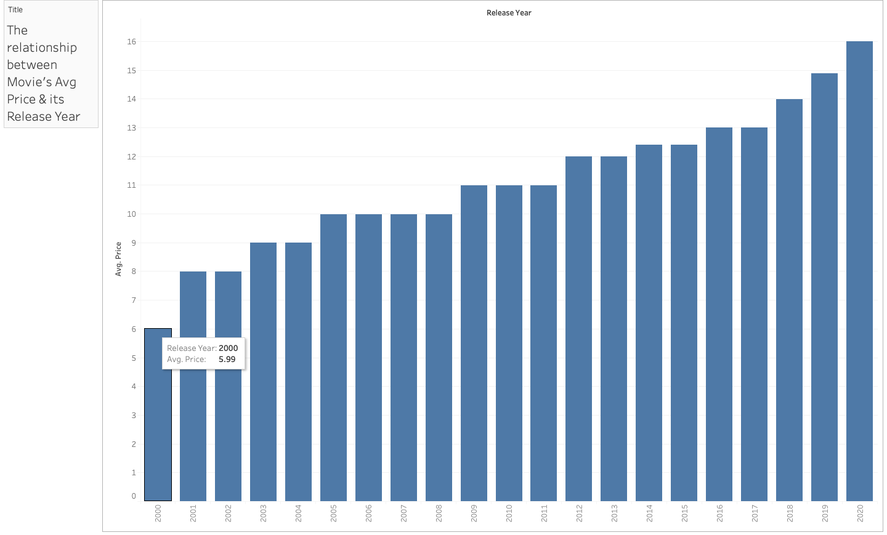
ONLINE MOVIE ORDER SYSTEM
| TABLEAU REPORT
X-axis: Movies’ Release Year
Y-axis: Movies’ Avg Prices
Increasing Trend ⬆️
INFO 6210 | Group 5 Final Project | Fangyu Cui & Fang-Wen Tseng & Jiawen Yin & Xiaohe Zhang

Slide 17
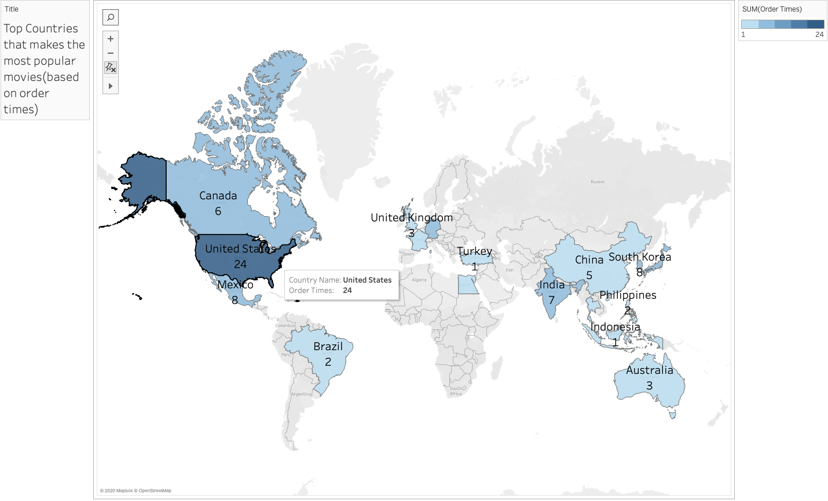
ONLINE MOVIE ORDER SYSTEM
| TABLEAU REPORT
INFO 6210 | Group 5 Final Project | Fangyu Cui & Fang-Wen Tseng & Jiawen Yin & Xiaohe Zhang

Slide 18
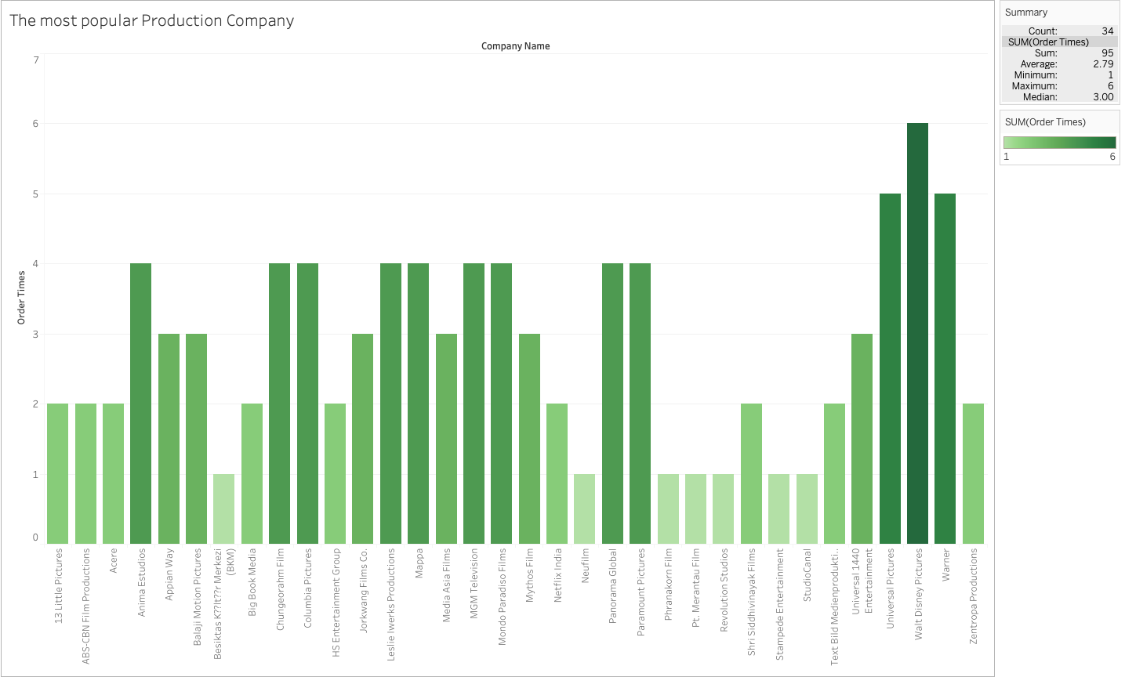
ONLINE MOVIE ORDER SYSTEM
| TABLEAU REPORT
Top 3 movie Production Company
(based on order times)
Walt Disney
Pictures
Universal Pictures
Warner
INFO 6210 | Group 5 Final Project | Fangyu Cui & Fang-Wen Tseng & Jiawen Yin & Xiaohe Zhang

Slide 19
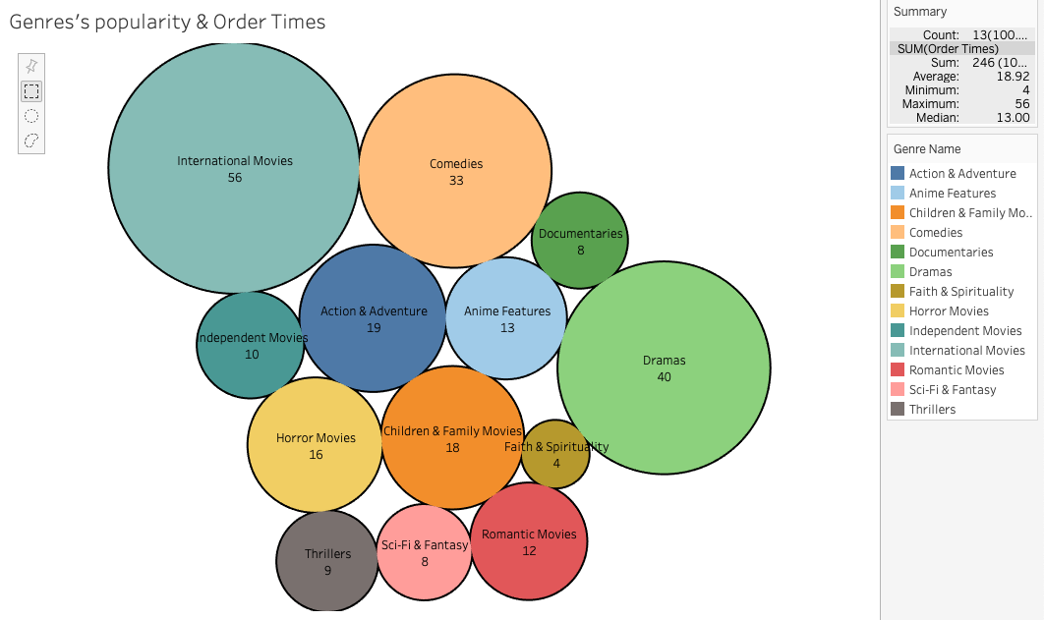
ONLINE MOVIE ORDER SYSTEM
| TABLEAU REPORT
Top 3 movies’ categories
International Movies
Dramas
Comedies
INFO 6210 | Group 5 Final Project | Fangyu Cui & Fang-Wen Tseng & Jiawen Yin & Xiaohe Zhang

Slide 20
Q & A
ONLINE MOVIE ORDER SYSTEM
| Q & A
INFO 6210 | Group 5 Final Project | Fangyu Cui & Fang-Wen Tseng & Jiawen Yin & Xiaohe Zhang

Slide 21

THANK YOU FOR LISTENING!
INFO 6210 | Group 5 Final Project
Fangyu Cui & Fang-Wen Tseng & Jiawen Yin & Xiaohe Zhang

